Slide 1
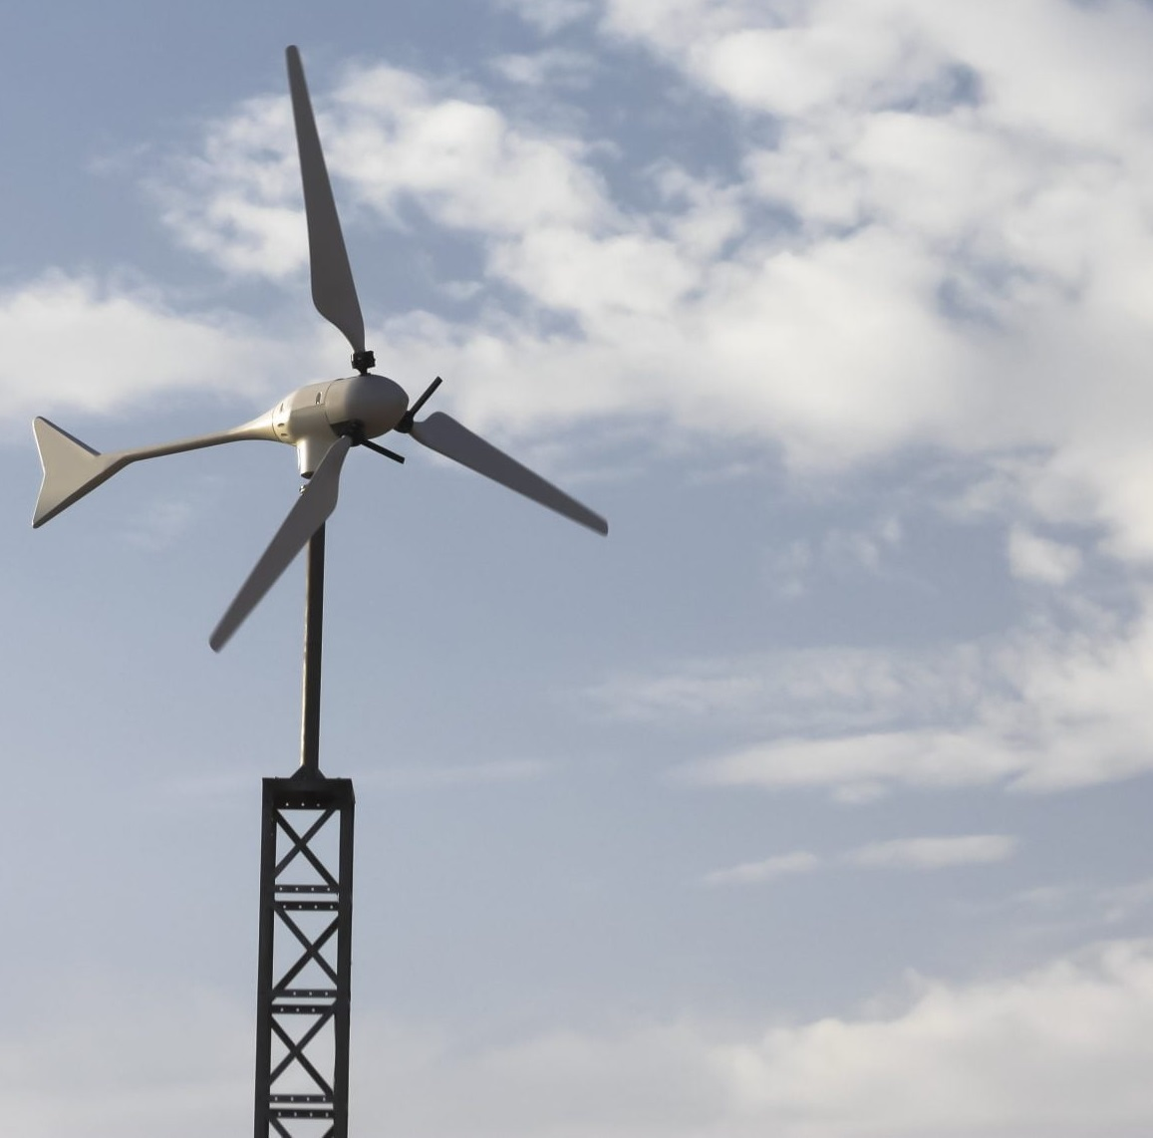

Team 7:
Wind-Powered Building
Team Members:
Colton, Reginald, Maxwell, Peter
Sponsor: Dr. Jang TA: Rohith Ramanujam Kumar
Final Presentation
Notes:
https://www.ryse.energy/3kw-wind-turbines/#iLightbox[gallery_image_1]/11

Slide 2
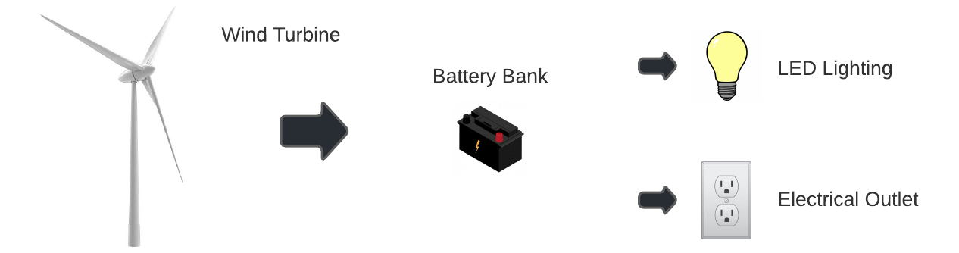
Problem Overview
Showcase that local renewable power generation is achievable to reduce reliance on fossil fuels
Using an AC power source to capture energy, store it in batteries, and power AC and DC loads

Slide 3
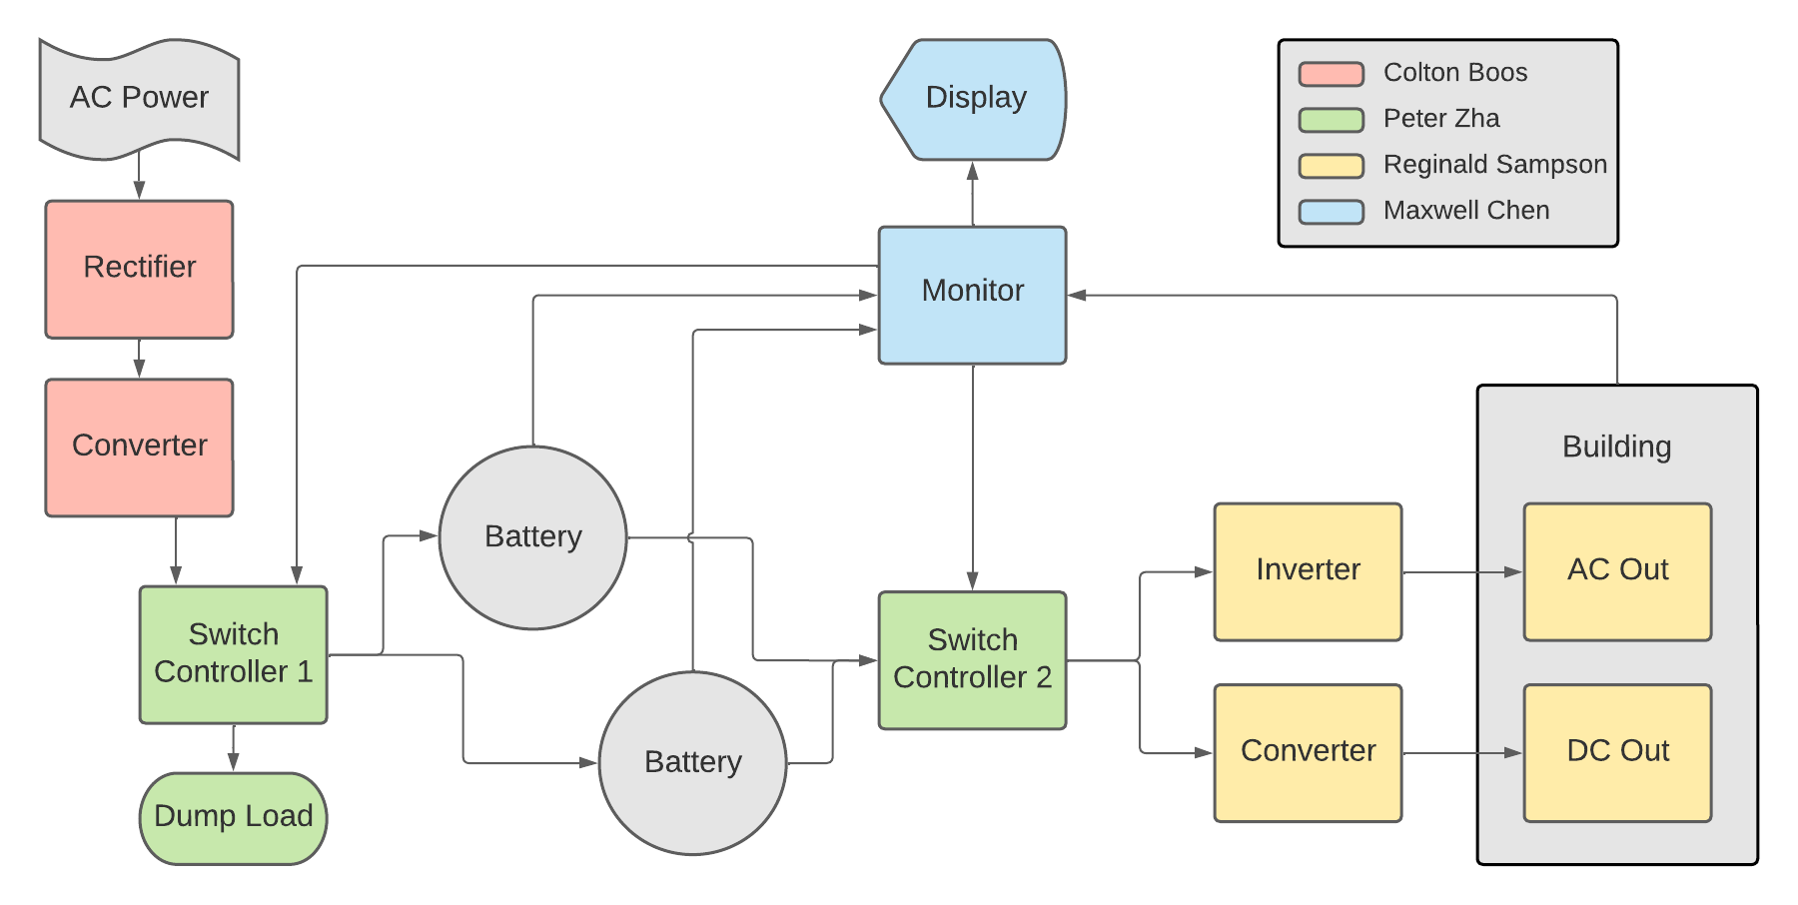
Integrated Project Diagram

Slide 4
Rectification and Conversion Subsystem
Owner: Colton Boos

Slide 5
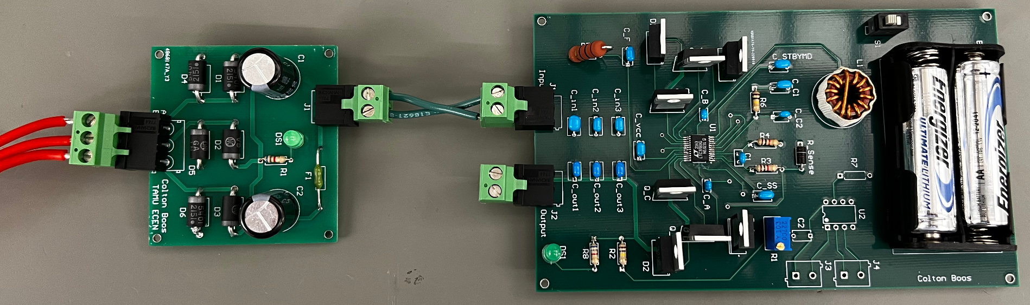
R&C Subsystem Overview
Owner: Colton Boos
Designed two PCBs
Three-Phase Rectifier PCB to convert AC to DC
Buck-Boost Converter PCB to charge batteries with a constant voltage

Slide 6
R&C Subsystem Challenges and Solutions
Owner: Colton Boos
Challenges | Solutions
PCB design for converter took longer than expected due to uncertain charging method | Implemented functionality for constant voltage or constant current or both
Converter IC is extremely sensitive to PCB layout and includes over 30 components | Following the datasheet and took my time designing to avoid mistakes
Decision to not use wind-turbine on 10/23 and to move to an AC power supply | Implemented my three-phase rectifier as a bridge rectifier

Slide 7
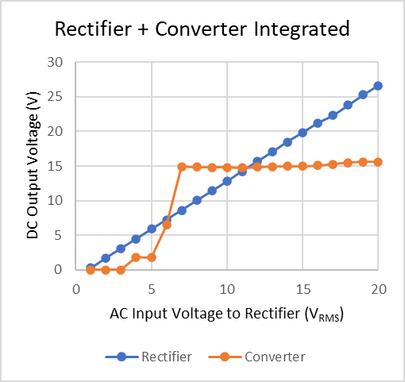
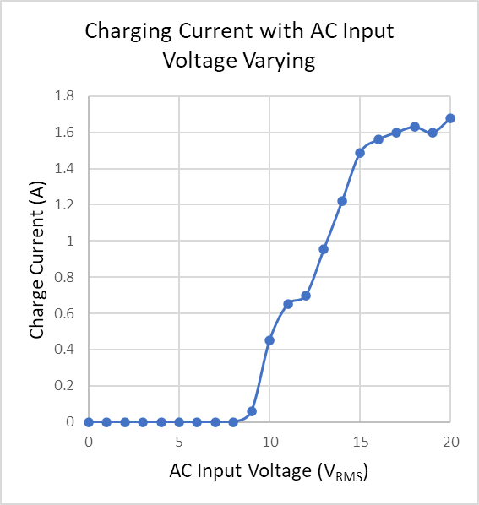
R&C Subsystem Results
Owner: Colton Boos

Slide 8
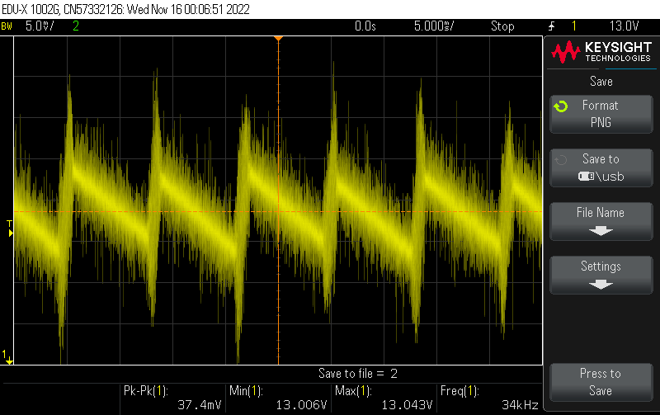
R&C Subsystem Results
Owner: Colton Boos
Measurement of Voltage Ripple from Rectifier

Slide 9
R&C Subsystem Results
Owner: Colton Boos
Test Name | Validation Requirements | Methodology | Status
AC-DC Conversion Test | 2-20VAC is rectified to corresponding DC with < 100 mV output ripple | Input AC voltage and measure corresponding output voltage | Completed
DC-DC Conversion Test | 6-20VDC is converted to set DC voltage, 14.8V | Input various DC voltages and measure corresponding output voltage | Completed
Charge Current Test | Current is greater than 10% of battery capacity, 0.72A, for charging our batteries | Input AC voltage to rectifier, with converter integrated, and measure current output with battery as a load | Completed
Rectifier and Converter Connection Test | Voltage outputs to set DC voltage, 14.8V | Input AC voltage to rectifier and measure output DC voltage of converter | Completed

Slide 10
Switch Controller Subsystem
Owner: Peter Zha

Slide 11
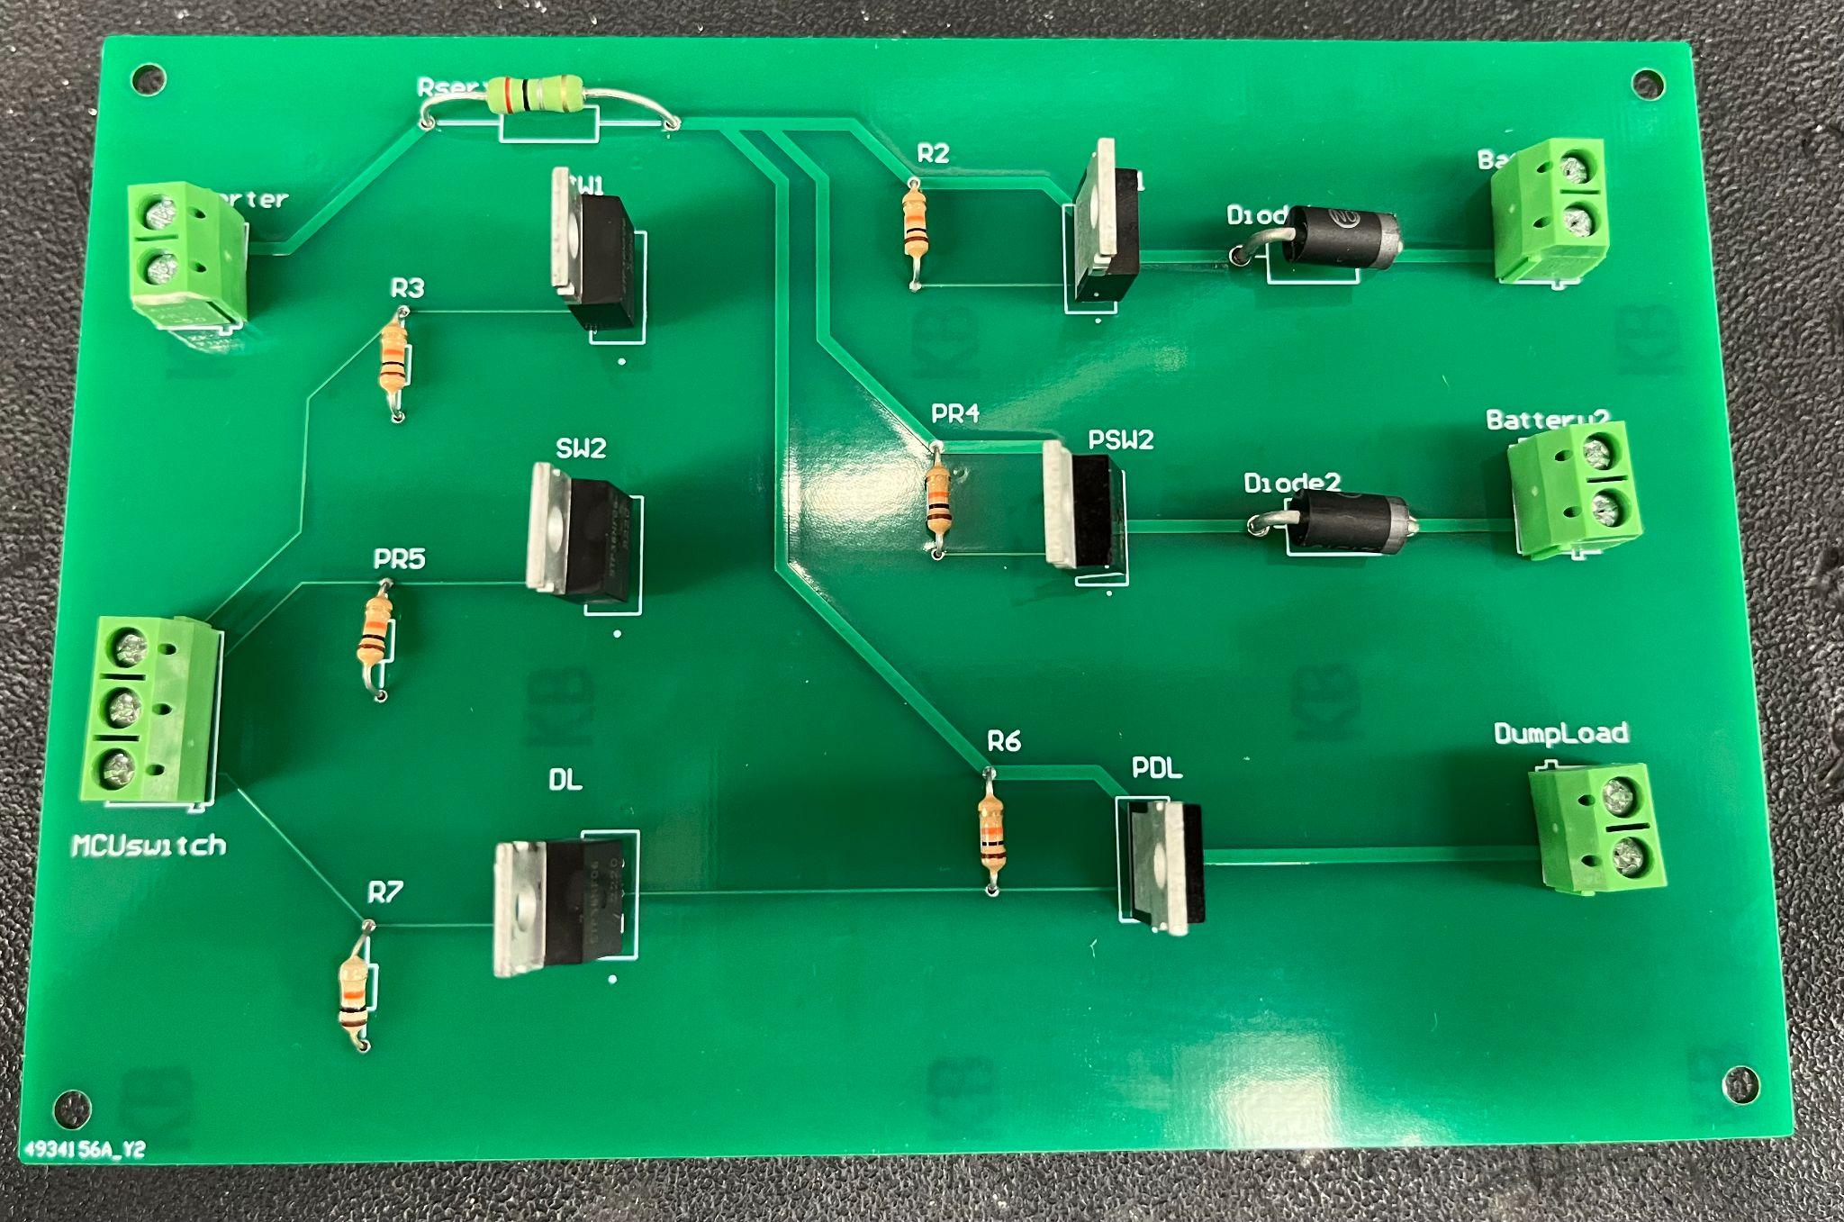
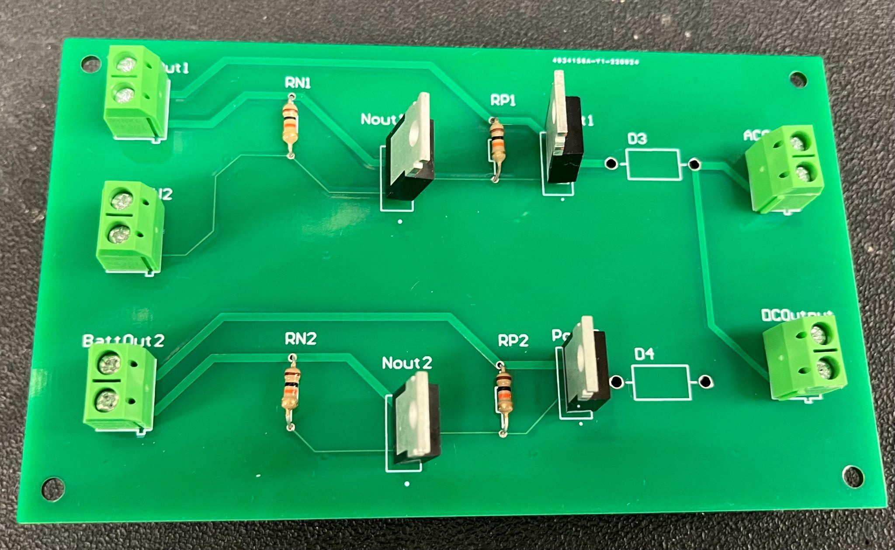
Switch Controller Subsystem Overview
Owner: Peter Zha
Switch between both batteries for charging and discharging
Design separate PCBs for input and output switches
Major changes from previous semester

Slide 12
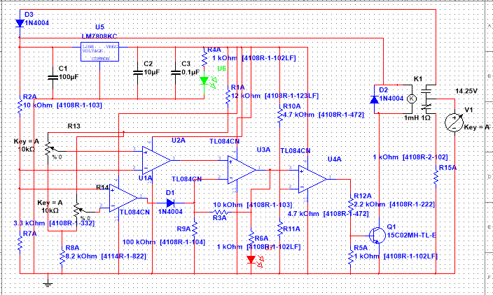
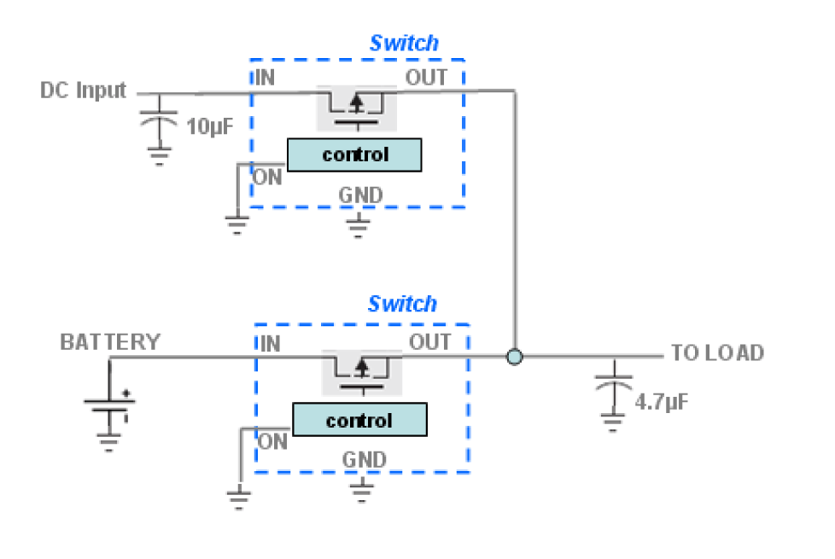
SC Subsystem Challenges and Solutions
Owner: Peter Zha
Challenges | Solutions
Fundamentally incompatible with MCU | Complete overhaul of design; removed relay and allows input from MCU
Relay did not properly switch circuits | Greater utilization of MOSFETs and high-side switching
Parasitic capacitance of MOSFET | Diodes, simple but at a slight cost

Slide 13
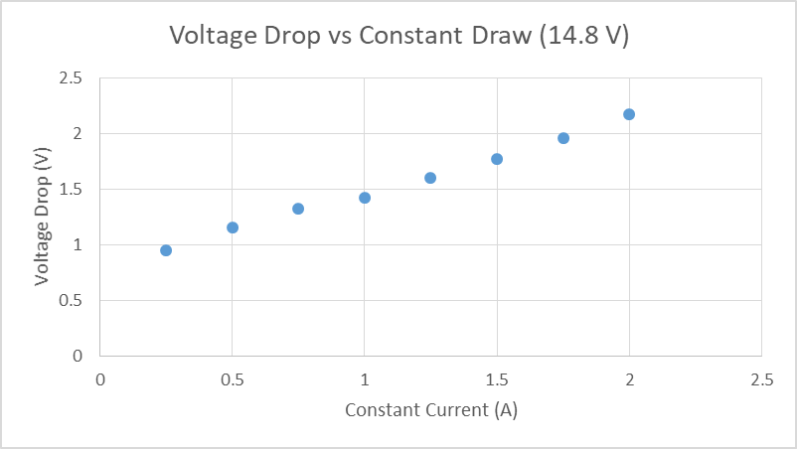
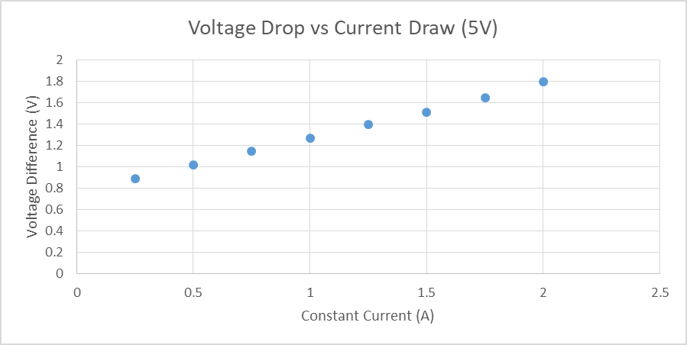
SC Subsystem Results
Owner: Peter Zha
Primary concern: power transfer - current and voltage
Current passes through fine
Voltage drop within expected values, but larger with increasing current - power loss at high current

Slide 14
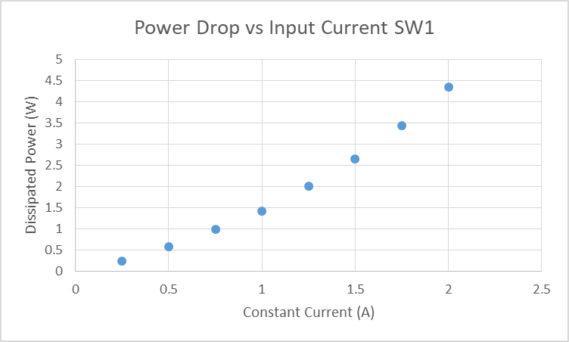
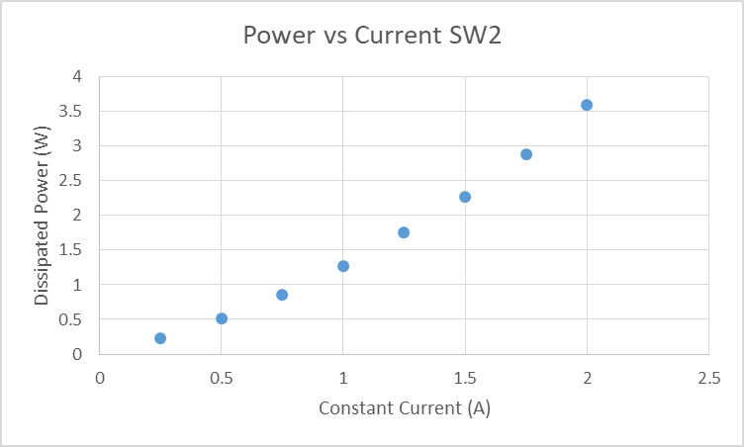
SC Subsystem Results
Owner: Peter Zha

Slide 15
SC Subsystem Results
Owner: Peter Zha
Test Name | Validation Requirements | Methodology | Status
Input/Output Test | Switch correctly transfers input power to output | Measure voltage and current at the load of the switch and compare with expected current and voltage values | Completed
Switch Validation | The switch correctly switches between outputs | Input signals from microcontroller and test combination of expected inputs/outputs and verify with voltage and current measurements. | Completed
Charge Batteries Test | Wind-Power is correctly charging the battery bank with appropriate switching maneuvers | Use wind-turbine to output power, measure if battery capacity has gone up | Completed
Power Output Test | Battery bank is used to power the load with appropriate switching maneuvers | Measure voltage and current at output when battery switches to determine proper switching of power. | Completed

Slide 16
Inversion and Conversion Subsystem
Owner: Reginald Sampson

Slide 17
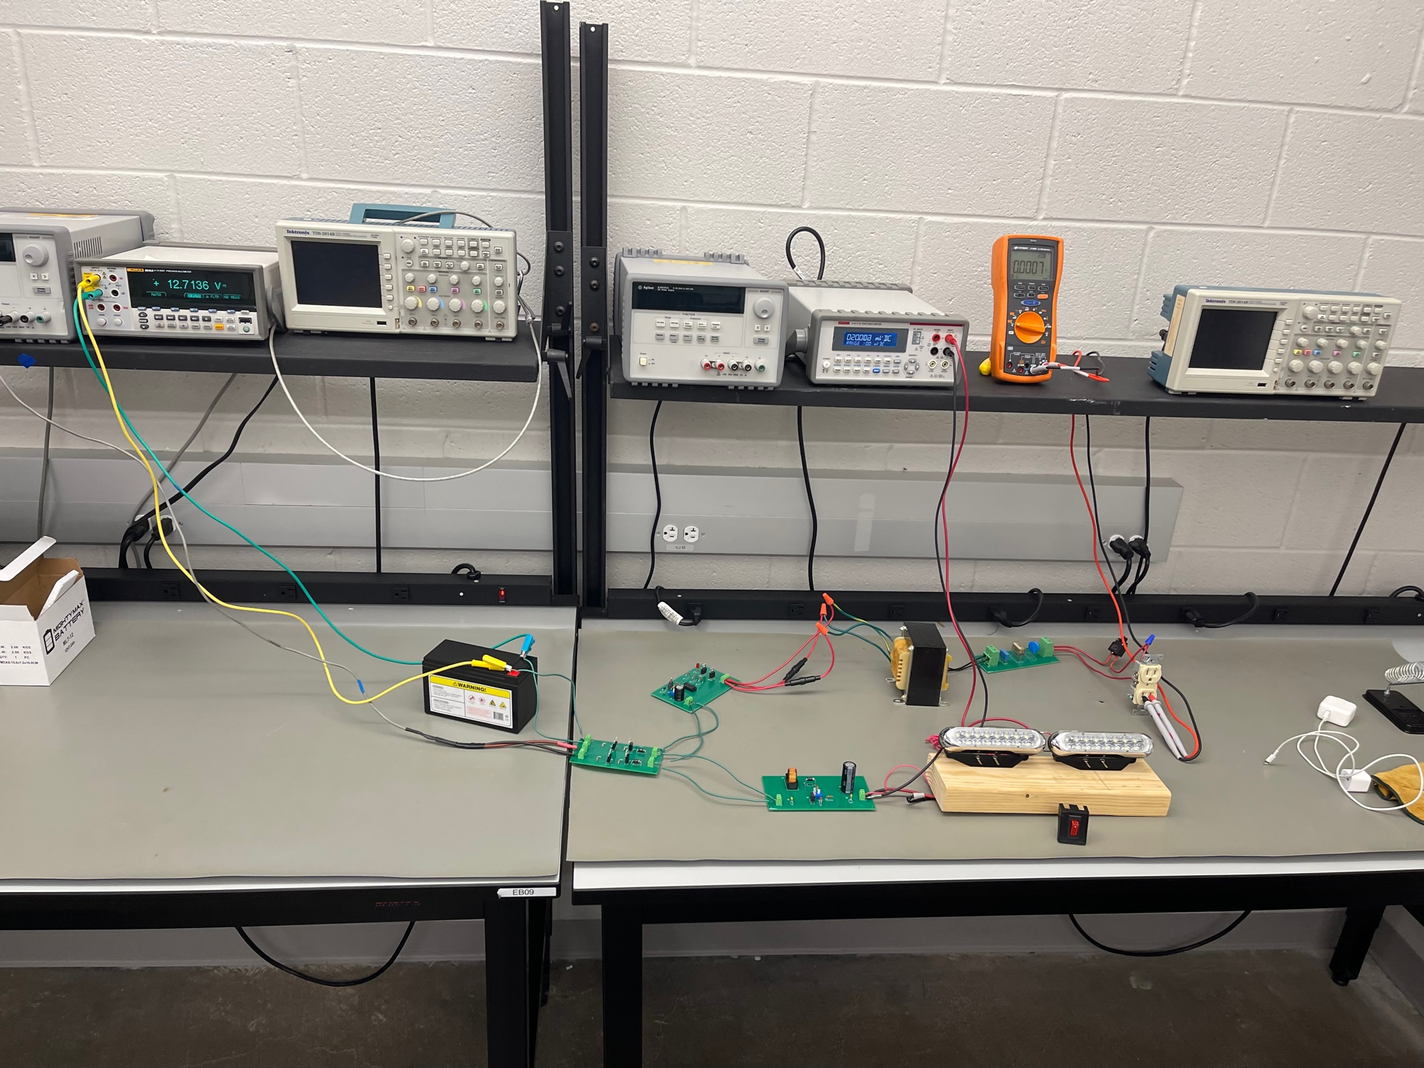
I&C Subsystem Overview
Owner: Reginald Sampson
Designed three PCBs
Inverter PCB to convert DC to AC
Boost Converter PCB to convert DC to boosted DC
Load Network PCB to filter voltage

Slide 18
I&C Subsystem Challenges and Solutions
Owner: Reginald Sampson
Challenges | Solutions
Inductor footprint on Converter PCB did not match actual size of inductor leads | Removed trace soldering mask for inductor holes, drilled bigger holes and resoldered new through hole pad
The inverter input is not high enough to produce the desired output | Use additional boost converter to boost inverter input or use current output
First transformer only allowed a load current draw of 0.4A | Replaced first transformer with a second transformer that allowed a load current draw of 3A
The second transformer costumes powers and draws current even when the inverter is an open circuit | Reexamined the terminal connections between the inverter and transformer and between the transformer and load

Slide 19
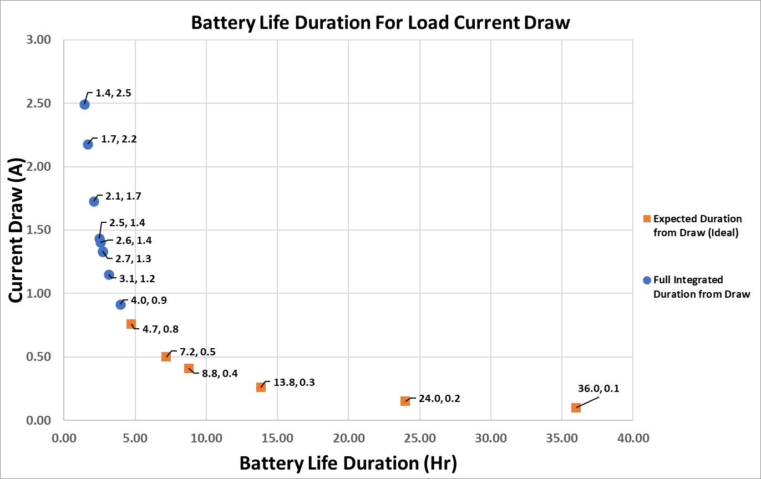
I&C Subsystem Results
Owner: Reginald Sampson
Comparison of the battery life duration between the expected and actual current draw
Expected current draw assumed to be 0.1 A at no load

Slide 20
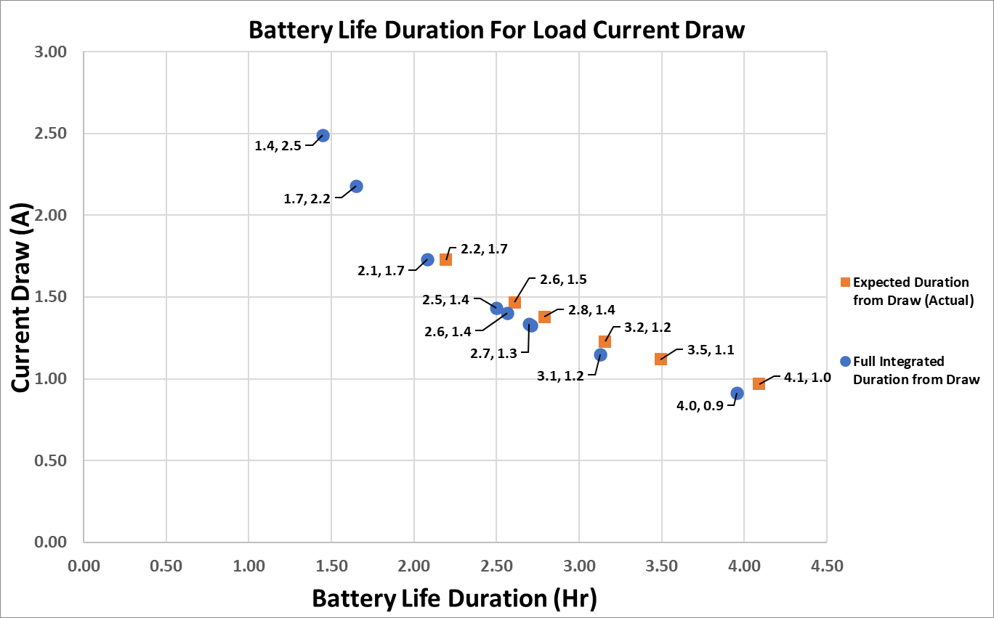
I&C Subsystem Results
Owner: Reginald Sampson
Expected current draw assumed to be ~0.97 A with no load

Slide 21
I&C Subsystem Results
Owner: Reginald Sampson
 | Full Integrated Duration from Draw
 | Battery Life Duration (HR) | Total Load Current Draw
No Load | 3.96 | 0.97
LEDS | 3.13 | 1.15
LEDS + Small Charger (w/ Airpods) | 2.71 | 1.33
LEDS + Big Charger (w/ Airpods) | 2.70 | 1.33
LEDS + Calculator | 2.57 | 1.40
Small Charger (w/ Iphone) | 2.50 | 1.44
LEDS + Small Charger (w/ Iphone) | 2.08 | 1.73
Big Charger (w/ Iphone) | 1.65 | 2.18
LEDS + Big Charger (w/ Iphone) | 1.45 | 2.49

Slide 22
I&C Subsystem Results
Owner: Reginald Sampson
Test Name | Validation Requirements | Methodology | Status
DC-AC Conversion Test | 12VDC is converted to 12VAC | Input DC voltage to the inverter and measure the output AC voltage before the transformer (with the transformer disconnected) | Completed
Transformer Step-up Test | Transformer output is 120VAC given 24VAC input | Input DC voltage to the inverter and measure the output AC voltage of the transformer using a digital multimeter | Completed
Inverter Output Test | Connected outlet outputs 120VAC and powers a load | Input DC voltage to the inverter and measure the output AC voltage of the transformer using a digital multimeter and plug in an iphone charger to the outlet | Completed
Converter with battery | Circuit elements function properly with battery voltage | Input DC voltage to the converter and measure the output DC voltage before the LEDs (with LEDs disconnected) | Completed
Converter Output | Converter output powers LED lights | Input DC voltage to the converter with the LEDs connected | Completed

Slide 23
Monitor Subsystem
Owner: Maxwell Chen

Slide 24
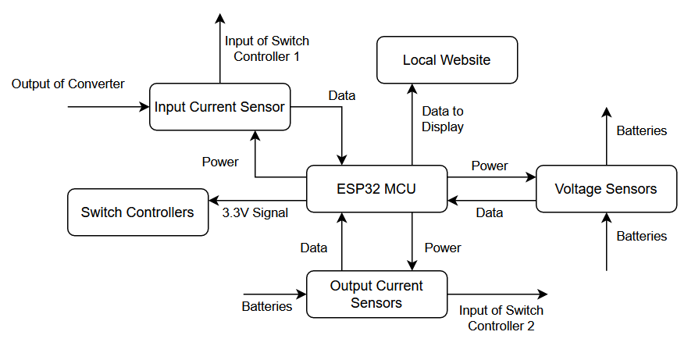
Monitor Subsystem Overview
Owner: Maxwell Chen
Collect data from Voltage and Current sensors on the state of the system
Process data to determine optimal charging sending signals to the Switch Controllers
Host a local website on the network to display information to the user

Slide 25
Monitor Subsystem Challenges and Solutions
Owner: Maxwell Chen
Challenges | Solutions
Addition of multiple sensors during 404, with the Output Current sensors in particular being not super accurate. | Counteract these inaccuracies through the usage of software with offsetting in the case of the Voltage sensors, and some averaging in the case of the Output Current sensors.
The addition of the graph onto the website caused conflicts with previously libraries used due to how it was programmed. | Completely changed the way the website functioned and how data was updated to fit in with the new libraries required to implement the graph.
Budget constraints limited what could be done with the monitor subsystem as it wasn’t crucial as other subsystems for the project to function as a whole. | Bought a fairly cheap mcu, and sensors. Initially there was going to be an actual display as well however that was scrapped as it was quite costly. All the parts are on a perfboard instead of a pcb to reduce costs.

Slide 26
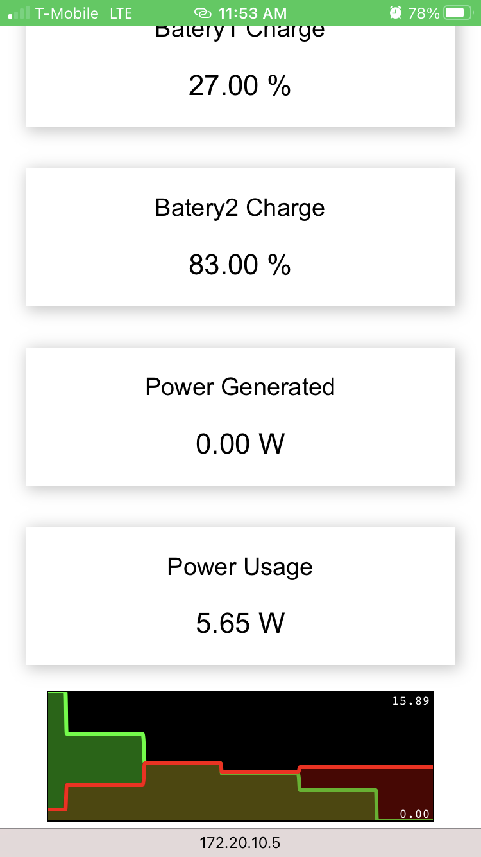
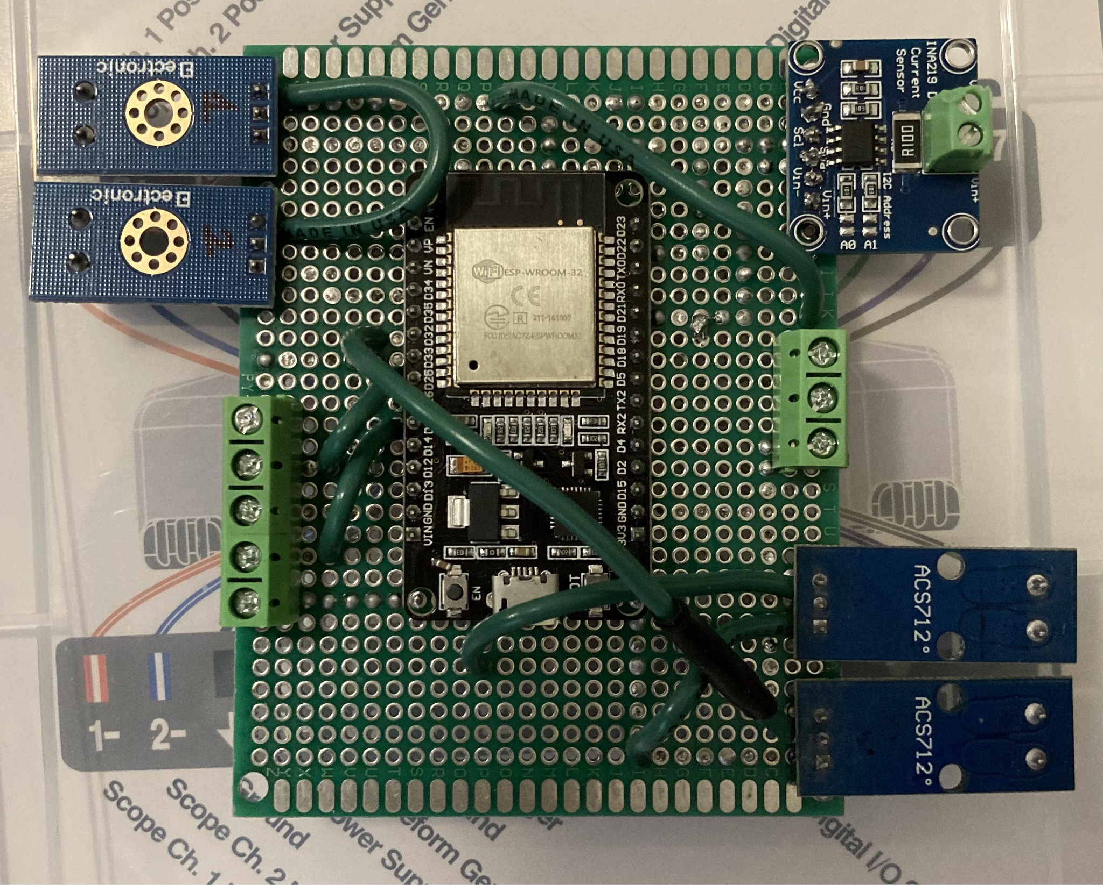
Monitor Subsystem Results
Owner: Maxwell Chen

Slide 27
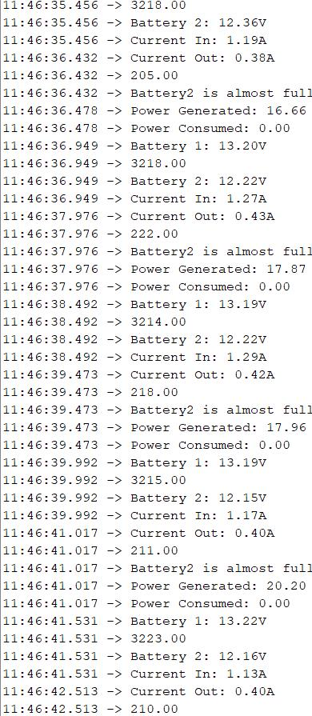
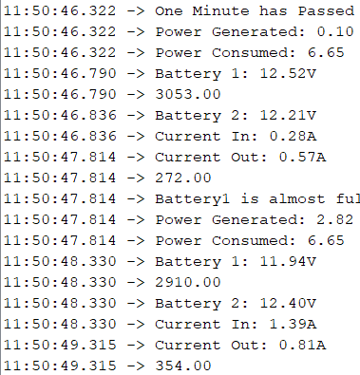
Monitor Subsystem Results
Owner: Maxwell Chen
Monitored voltage and current on the Console and compared it with multimeters hooked up to the system
Current sensors are fairly accurate but there is some offset of around 0.05A
Voltage varies based on which battery is being used and charged

Slide 28
Monitor Subsystem Results
Owner: Maxwell Chen
Test Name | Validation Requirements | Methodology | Status
Battery Capacity Monitor | System is able to successfully track the capacity of the battery | Inputing a voltage and current source into the system or by testing with the actual batteries to see if it can accurately track how much charge is left | Completed
Display Power Generated and Power Usage | System is able to display the power generated from the Wind Turbine, and the power used by the building | Similar to the battery capacity portion there needs to be a voltage and current source to test if this portion is working correctly. | Completed
Display Battery Health | System will be able to calculate the battery health each battery and display this information to the user allowing them to know if they should replace the battery soon or not | Similar to the battery capacity portion there will need to be a current source to replicate the usage and flow of charge through a battery and seeing if it is able to accurately calculate the health of said battery. | Removed
Website for System Monitoring | Website is accessible and cleanly display information about the entire system | Once other parts of the systems are setup the website should be able to correctly display information to the user | Completed
Output Signal for Switch Controller | System will have determine when each battery should be charged and used for optimal energy consumption. Outputting a signal to the switch controller | Once connected with the charge and switch controller check that the system is correctly outputting signals to the controller and that the controller is performing the correct result | Completed

Slide 29
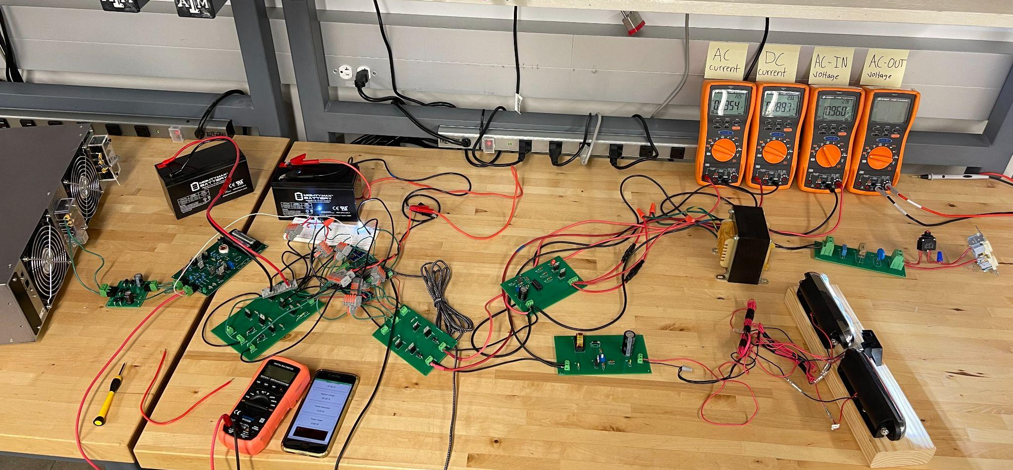
Integrated System Results

Slide 30
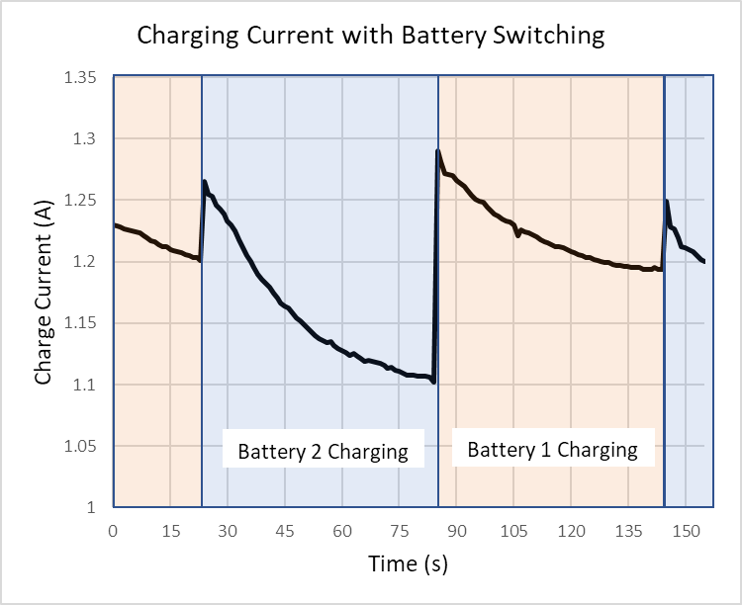
Integrated System Results
Using an ideal power source to showcase battery charging and integration
Maxwell sending switching signals
Peter’s circuit transferring power
Colton’s circuits transforming AC power into usable energy

Slide 31
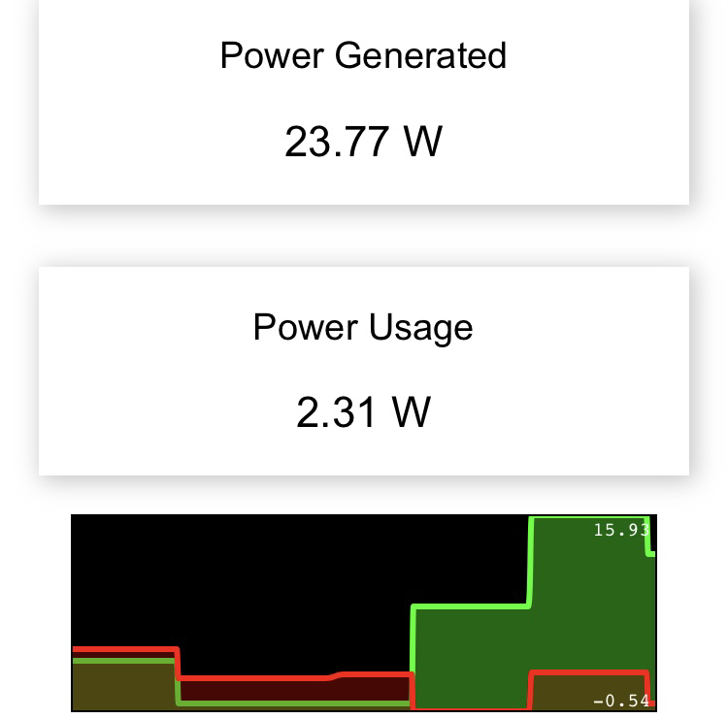
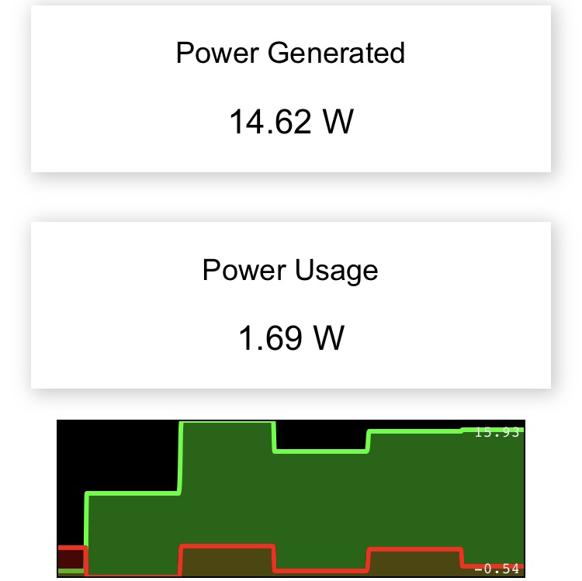
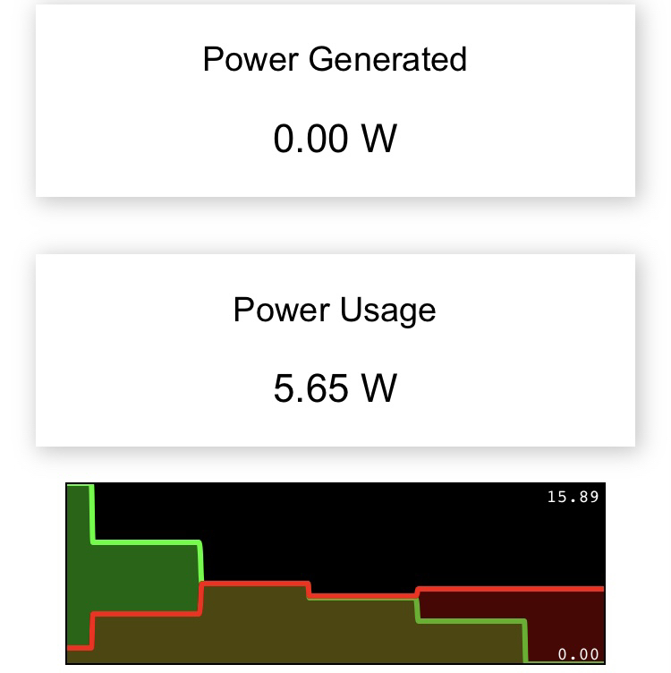
Integrated System Results and Common Use Scenario
Full system test with monitoring of power generation and power usage
Seamless switching between Battery 1 and Battery 2
Power measured corresponds with replicated conditions (turbine on/off, low and high voltage)

Slide 32
Conclusions
Using an AC power supply instead of wind-turbine due to its low power output
The system is functional, and with implementation of the right wind-turbine, the system is a complete product
Integration complete, validated input and output according to expectations
Battery monitoring data focused on current draw and a changing voltage reference
Component housing still in progress

Slide 33
Thank you for listening
Any Questions?
Notes:
https://www.ryse.energy/3kw-wind-turbines/#iLightbox[gallery_image_1]/11

